Slide 1

Advanced Monitoring System for Enhancing Solar-Powered Electric Vehicle Efficiency Using a Smoothing Function Circuit for Reliable Power Distribution
JAWAHARLAL NEHRU TECHNOLOGICAL UNIVERSITY ANANTAPUR COLLEGE OF ENGINEERING KALIKIRI
DEPARTMENT OF ELECTRICAL AND ELECTRONICS ENGINEERING
BATCH NO-13:- Under the guidance of:-
G.KARTHIK - 21KA1A0254 Mrs . M.MEHETAJ, M.Tech
H.SANDHYA BAI – 22KA5A0206 Assistant Professor(Ad-hoc)
N.NANDINI - 21KA1A0238 Department of EEE
B.KALPANA - 21KA1A0239 JNTUACEK
Signature of the Guide

Slide 2
CONTENTS:-
OBJECTIVES
ABSTRACT
INTRODUCTION
LITERATURE SURVEY
METHODOLOGY
SIMULATION
RESULT ANALYSIS
CONCLUSION
REFERENCES

Slide 3
OBJECTIVES:-
To design photovoltaic panel with Maximum power point tracking for optimal power extraction and energy management.
To design and develop an advanced monitoring system for real-time tracking of solar input, battery performance, and energy consumption in a solar-powered electric vehicle.
To enhance vehicle efficiency by using real-time data to optimize energy usage, minimize losses, and improve battery management.
To implement a smoothing function circuit that reduces voltage and current fluctuations, ensuring stable and continuous power supply.
To ensure reliable power distribution by intelligently managing the flow of energy between the solar panel, battery, and electric motor.

Slide 4
ABSTRACT:-
The growing demand for sustainable transportation has accelerated the development of solar electric vehicles. While these vehicles offer a promising alternative to fossil fuel-dependent hybrid electric vehicles by utilizing clean solar energy, fluctuations in solar power generation can adversely affect performance and battery life. This project aims to develop a reliable solar-powered vehicle system that reduces fuel consumption and greenhouse gas emissions.
To address the instability of solar energy, a smoothing function circuit is integrated to ensure a consistent power output. Additionally, a real-time monitoring system is implemented to track energy flow, battery health, and system performance, enabling proactive maintenance and optimized energy management. Using MATLAB Simulink, the study designs, simulates, and analyzes a solar PV battery-powered system that delivers stable performance, enhanced reliability, and eco-friendly transportation.

Slide 5
INTRODUCTION:-
Solar Electric Vehicles utilize photovoltaic technology to convert sunlight into electricity, providing a sustainable alternative to fossil-fuel-powered transportation. However, variations in solar energy output leads to voltage and current fluctuations, affecting battery efficiency and motor performance. To address this, a smoothing function circuit is employed to regulate power flow and stabilize electrical output. By enhancing Maximum Power Point Tracking (MPPT) efficiency, it improves energy management, extends battery lifespan, and protects electronic components. The integration of smoothing circuits in SEVs is essential for optimizing performance, ensuring reliability, and advancing solar-powered mobility solutions.
The project can be classified into four main systems which includes:-
Solar System
Energy Storage System
BLDC Motor
Monitoring System

Slide 6
LITERATURE SURVEY:-
T.S. Biya and Dr.M.R.Sindhu[1] about the integration of Solar Electric Vehicle with Energy Storage System and the analysis of the energy storage system mitigate fluctuations in power and performance of the vehicle, control strategies employed to achieve a stable power output ensuring consistent energy supply.
Wajahat Khan and Furkan Ahmad[2] the integration of Smoothing Function Circuit with solar Electric Vehicle and also analysis of inductor in reducing the efficiency and lifespan of the battery system and maintaining the stable power supply in solar electric vehicles.
Murai Lal Azad[3] about the designing of solar electric vehicle with energy storage system and integration of the circuit with the bidirectional dc-dc converter and also the analysis of battery controller.
Mukesh Singh[4] about the monitoring system of the vehicle in MAT LAB and simulation of the vehicle and evaluating the parameters of the vehicle BLDC(Brushless D.C)motor design with decoder and gate circuit help for specific position of motor .

Slide 7
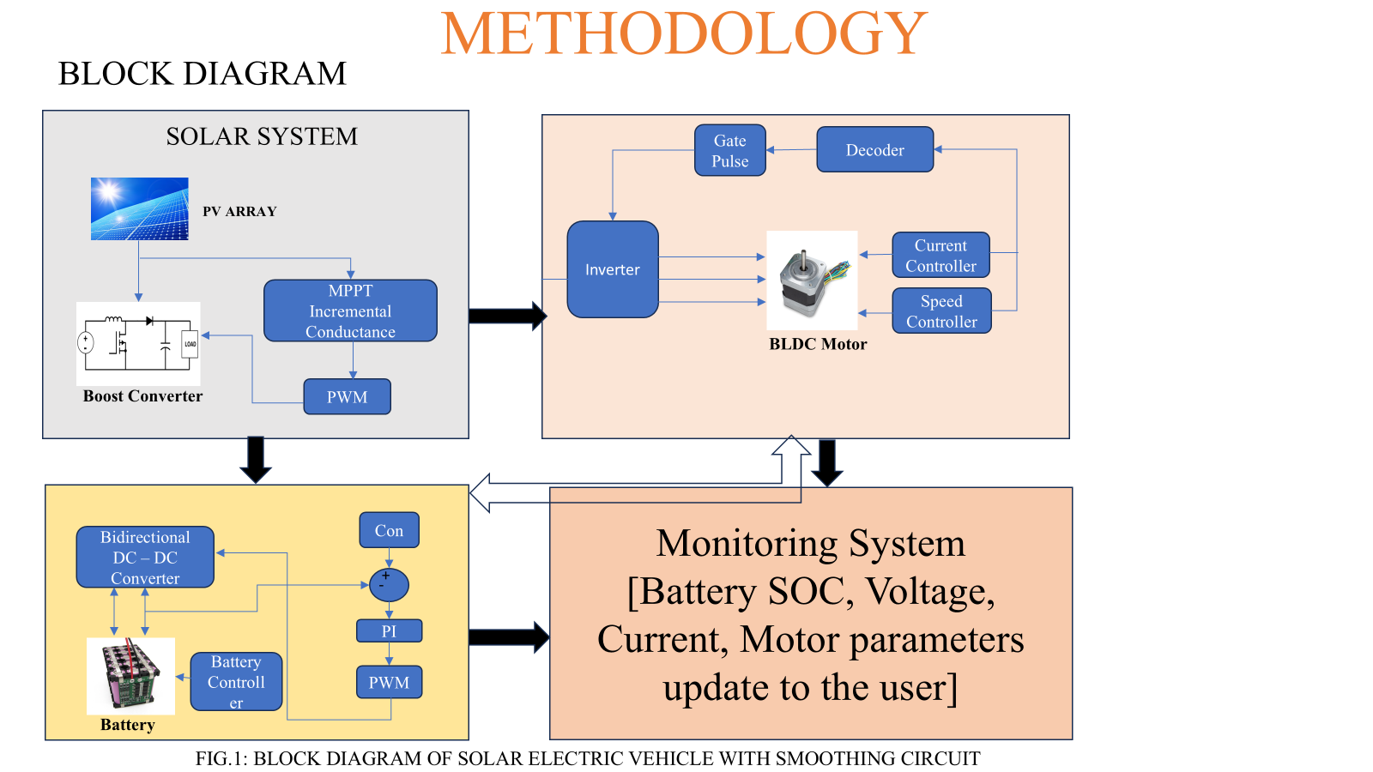
METHODOLOGY :- BLOCK DIAGRAM
FIG1 : Block Diagram of the project

Slide 8
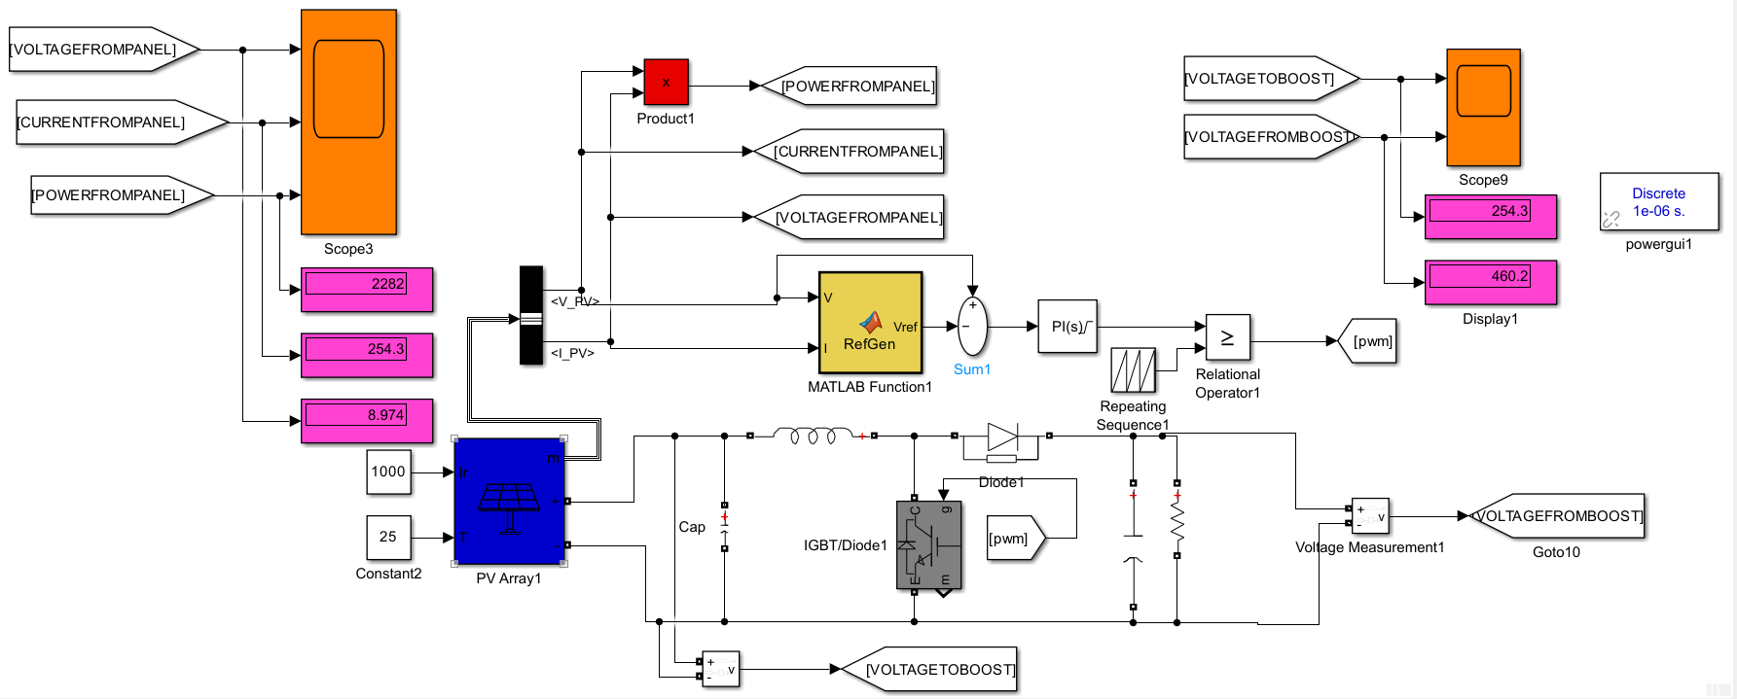
WORK DONE:-
Simulink diagram of Photo Voltaic system:-
FIG 2 :- Simulation diagram of Photo Voltaic system with INC(Incremental conductance) MPPT Technique

Slide 9
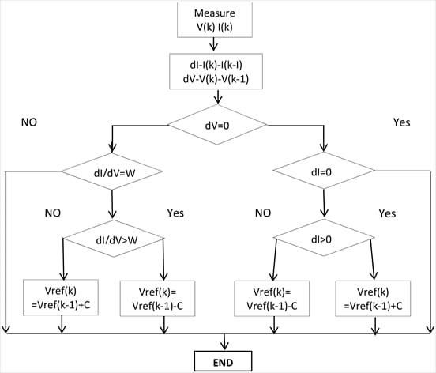
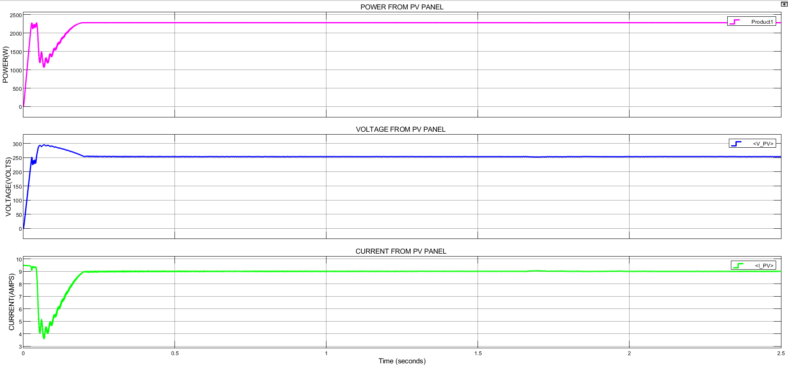
Result analysis of Photo Voltaic system :-
WORK DONE(contd…..)
FIG .3 :- Incremental Conductance MPPT Algorithm
FIG .4 :- Photo Voltaic system simulated graphs

Slide 10
The MATLAB output illustrates the performance of a photovoltaic (PV) system utilizing the Incremental Conductance algorithm for Maximum Power Point Tracking (MPPT). Initially, the power, voltage, and current exhibit transient behavior as the algorithm rapidly adjusts to locate the maximum power point. The power rises sharply, peaking above 2287 W, with brief oscillations before stabilizing, indicating successful MPPT. Similarly, the voltage overshoots slightly before settling around 254 V, and the current dips briefly before stabilizing near 8.8 A.
Parameter | Single Module Rating At STC(Standard test conditions) | System Rating At STC
Voltage | 31.77V | 31.77*8=254.16V
Current | 8.98A | 8.98A
Power | 285.29W | 285.98*8=2287W
Table shows parameters of the solar panel

Slide 11
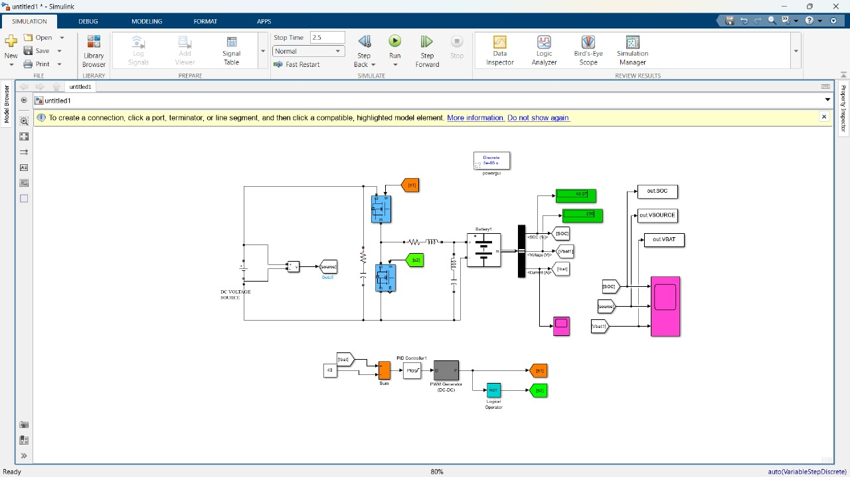
Simulink diagram of a Battery management system:-
WORK DONE(contd…..)
FIG .5 :- Simulation of Battery management system

Slide 12
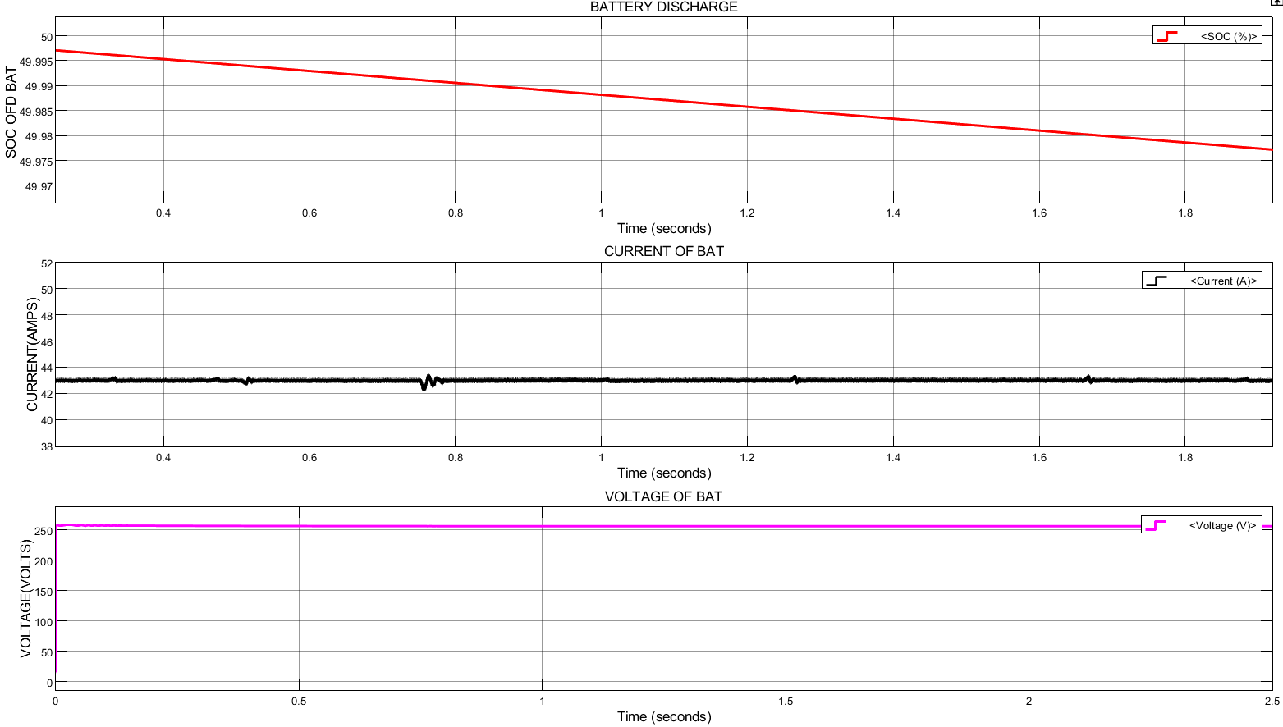
Result Analysis of a battery storage system:-
WORK DONE(contd…..)
Battery Parameters
SOC of Battery=50%
Discharge Current=43.42A
Discharge Voltage=254V
FIG .6 :- Battery simulated outputs

Slide 13
[FIG 6] shows a linear decline in the State of Charge (SOC) of 50% indicating steady energy consumption as the battery discharges to supply power. The middle plot shows the battery current, which remains nearly constant with minor ripples or spikes, suggesting a relatively stable load demand with brief dynamic changes—possibly due to switching or load fluctuations in the motor or converter. The bottom graph shows the battery voltage, which stays steady at around 254V throughout the interval, indicating that the battery is operating within a healthy voltage range despite discharging.

Slide 14
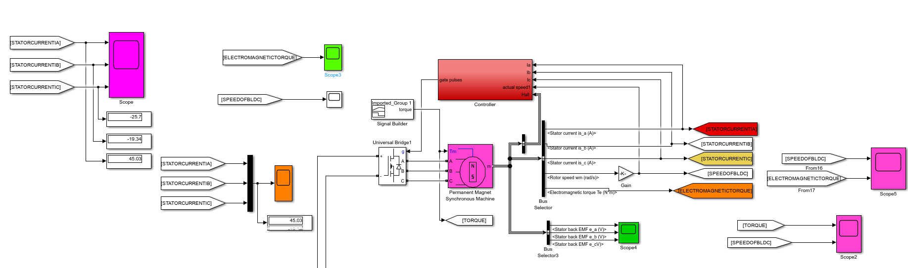
WORK DONE(contd…..)
Simulink diagram of BLDC Motor :-
FIG.7:- Simulink diagram of BLDC Motor

Slide 15
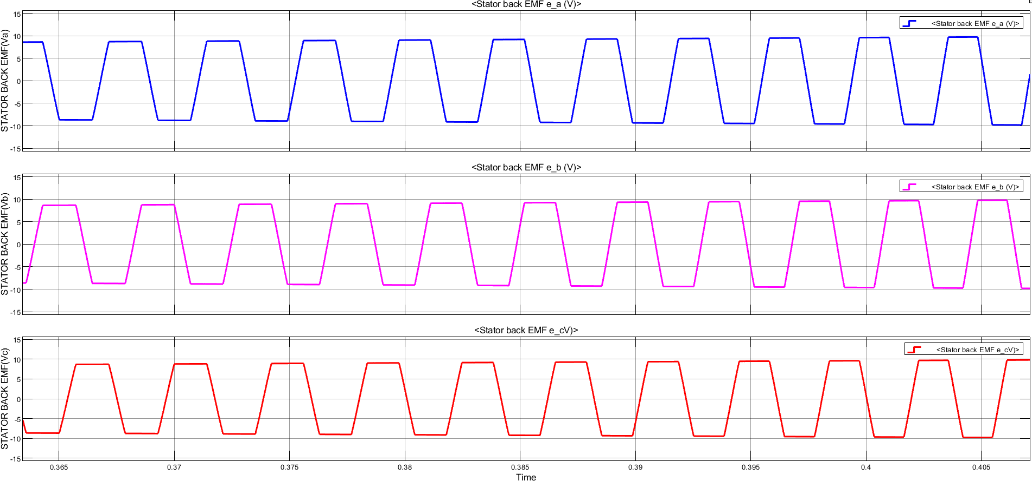
Result Analysis of a Stator Back EMF:-
WORK DONE(contd…..)
Back EMF=9.94V
FIG .8:- Waveforms of Stator Back EMF

Slide 16
[FIG.8] waveforms represent the trapezoidal back EMF (electromotive force) of a three-phase BLDC motor, showing the EMF for phases A, B, and C, each shifted by 120°. These EMFs are generated as the rotor's permanent magnets rotate past the stator windings, inducing voltages that alternate between approximately +10V and -10V. The trapezoidal shape is characteristic of BLDC motors and is essential for their operation, as it allows for electronic commutation using Hall sensors techniques that detect the zero-crossing of back EMF. These waveforms are used by the motor controller to determine switching points for the inverter, ensuring proper phase alignment and torque production.

Slide 17
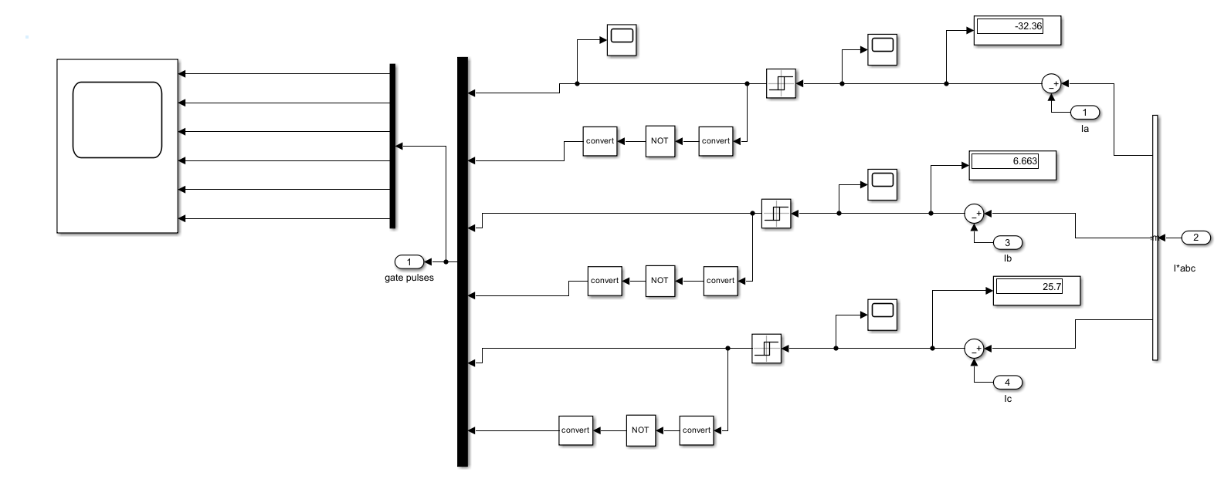
WORK DONE(contd…..)
Simulink diagram of Current Controller :-
FIG 9 :-Current controller for BLDC Motor

Slide 18
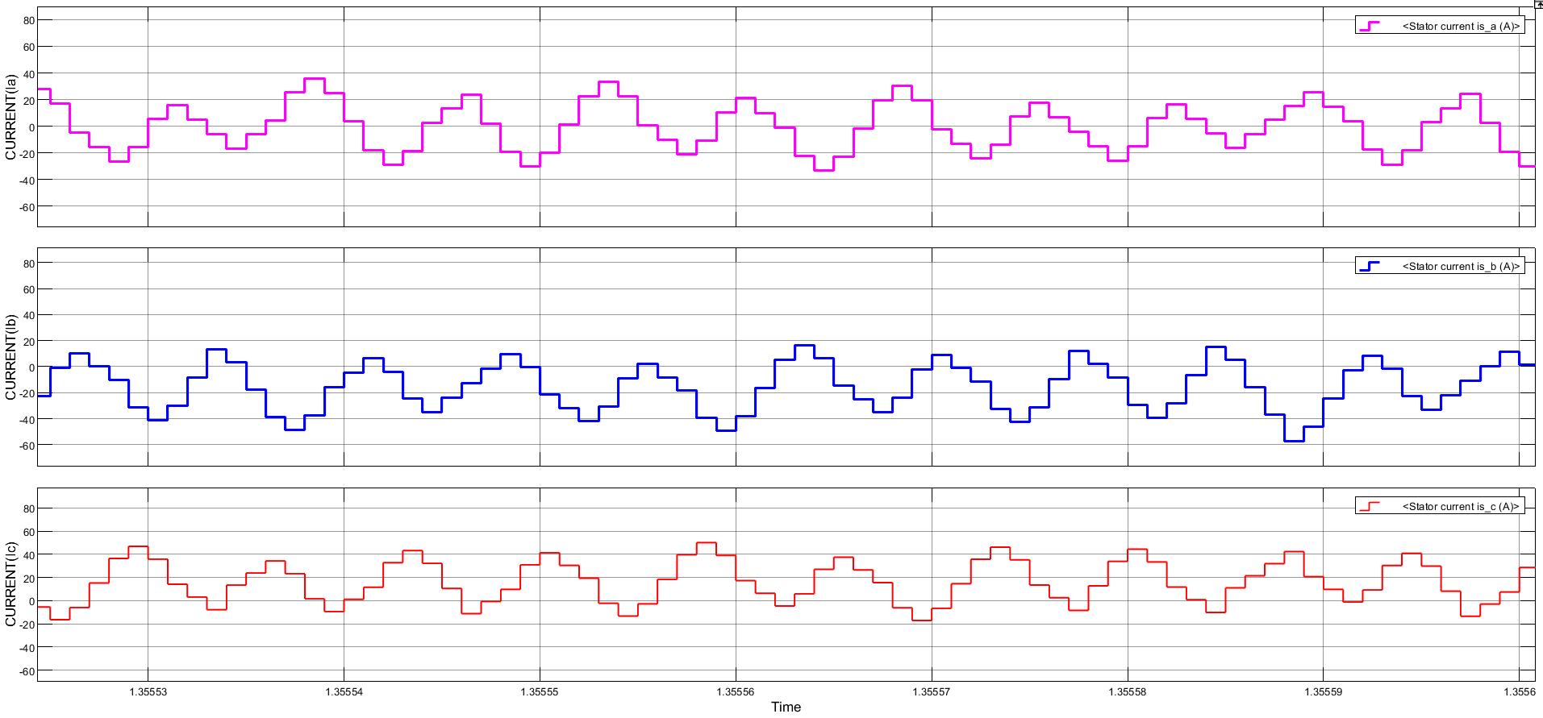
WORK DONE(contd…..)
Result Analysis of Stator Currents :-
Stator Current Parameters
Current=31.57A
FIG.10:- Waveforms of Stator Currents

Slide 19
[FIG.10] shows the stator current profiles for the three phases (Ia, Ib, Ic) of a BLDC motor used in a solar-powered vehicle This means that each phase conducts current for 120 electrical degrees while remaining off for the other 240°, resulting in a stepped waveform with distinct flat tops and zero-current intervals. The waveforms are 120° out of phase with each other, ensuring smooth torque production. The current shapes indicate that electronic commutation is functioning correctly, and the inverter is switching the motor windings properly in response to rotor position. These currents represent the motor drawing power from the battery (as seen in the earlier battery plot) to drive the vehicle.

Slide 20
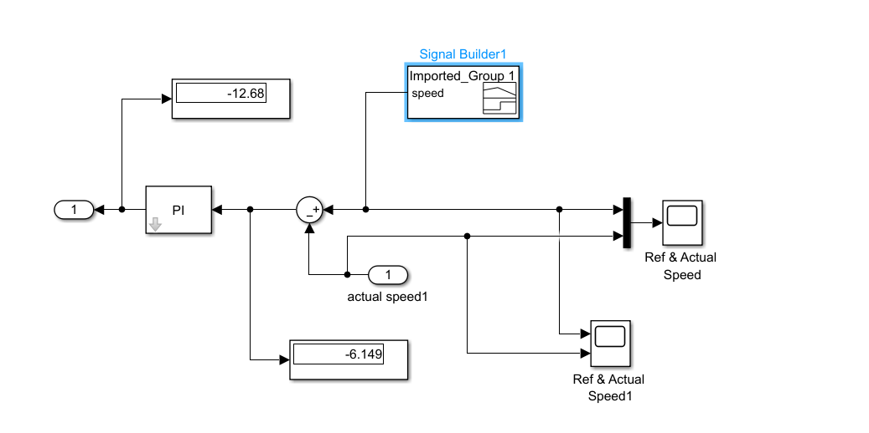
WORK DONE(contd…..)
Simulink diagram of Speed Controller :-
FIG.10:- Simulink diagram of Speed Controller

Slide 21
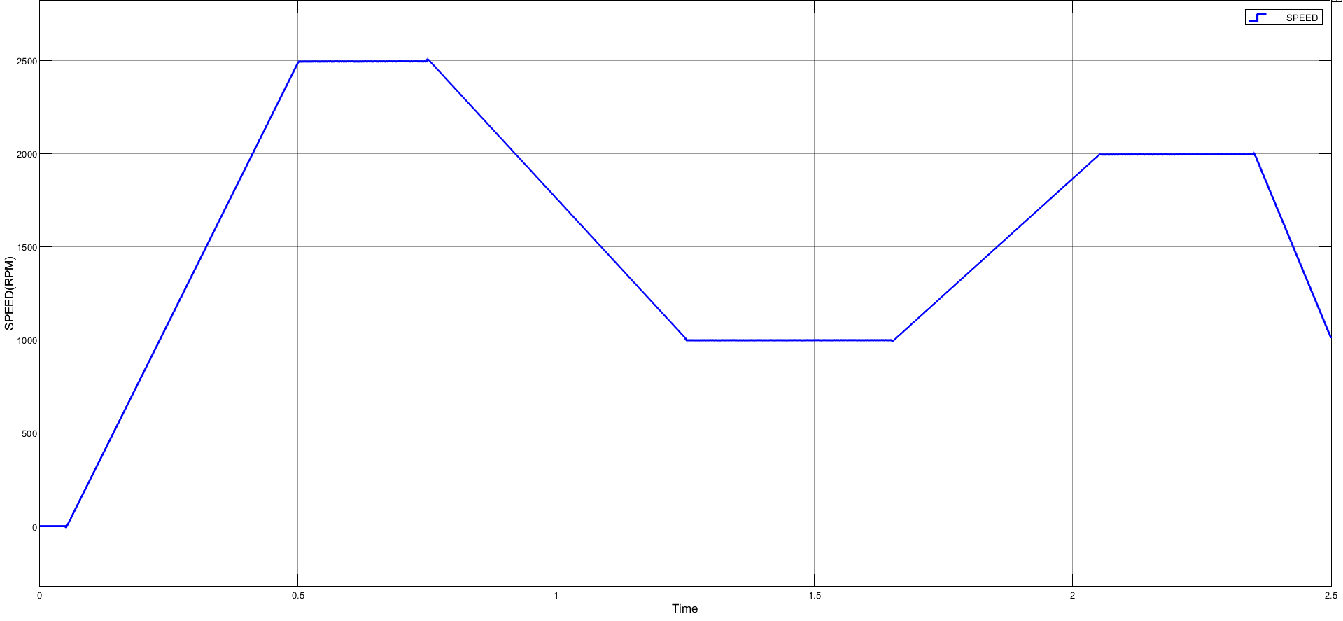
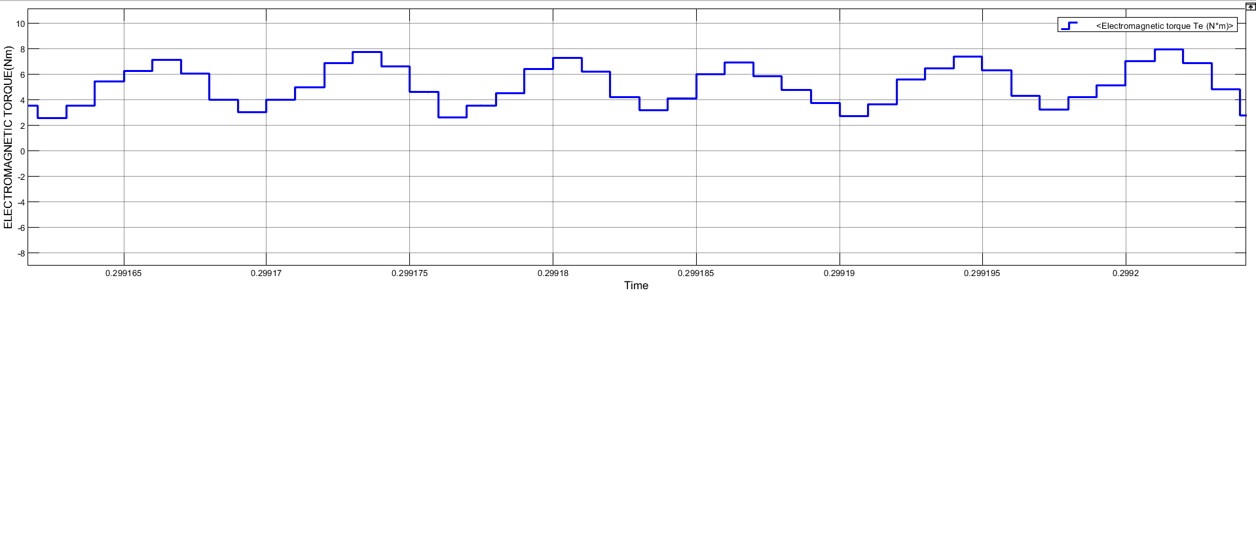
WORK DONE(contd…..)
Result Analysis of Motor Speed and Torque:-
Speed=(0-2500)R.P.M
Torque=8 N-m
FIG.11:- waveforms of motor speed and torque

Slide 22
[FIG.11] shows that the motor follows a controlled speed profile, gradually accelerating to a peak speed of 2500 RPM, maintaining steady operation, and then decelerating as expected. The corresponding torque waveform indicates a relatively stable electromagnetic torque output around 8Nm. Overall, the waveforms demonstrate effective motor performance under varying speed conditions, confirming the reliability and stability of the control strategy implemented.

Slide 23
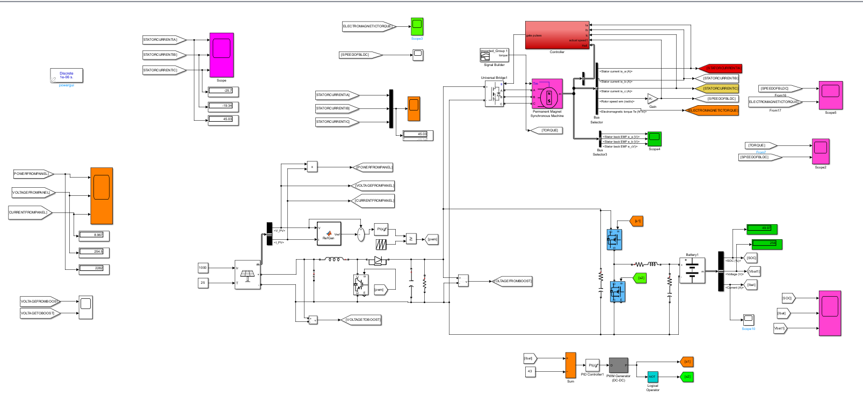
WORK DONE(contd…..)
Simulink diagram :-
FIG.12:- Simulink diagram

Slide 24
WORK DONE(contd…..)
Monitoring System :-
SMTP Code
def send_email(b):
try:
if not upload_widget.value:
print("❌ Please upload an image first!")
return
# Get uploaded file
uploaded_filename = list(upload_widget.value.keys())[0]
image_data = upload_widget.value[uploaded_filename]['content']
# Get user inputs
SENDER_EMAIL = sender_email.value
SENDER_PASSWORD = sender_password.value
RECEIVER_EMAIL = receiver_email.value
# SMTP Server Details
SMTP_SERVER = "smtp.gmail.com"
SMTP_PORT = 587
# Create email message
msg = EmailMessage()
msg["Subject"] = "Here is your image!"
msg["From"] = SENDER_EMAIL
msg["To"] = RECEIVER_EMAIL
msg.set_content("Please find the attached image.")
import smtplib
import os
from email.message import EmailMessage
from ipywidgets import FileUpload, Text, Password, Button, VBox
from IPython.display import display
# Create widgets
upload_widget = FileUpload(accept=".jpg", multiple=False) # Accept only .jpg images
sender_email = Text(description="Sender Email:", placeholder="your_email@gmail.com")
sender_password = Password(description="App Password:")
receiver_email = Text(description="Receiver Email:", placeholder="receiver_email@gmail.com")
send_button = Button(description="Send Email", button_style="success")
# Display widgets
display(VBox([upload_widget, sender_email, sender_password, receiver_email, send_button]))

Slide 25
# Attach the uploaded image
msg.add_attachment(image_data, maintype="image", subtype="jpeg", filename=uploaded_filename)
# Send email
with smtplib.SMTP(SMTP_SERVER, SMTP_PORT) as server:
server.starttls() # Secure the connection
server.login(SENDER_EMAIL, SENDER_PASSWORD)
server.send_message(msg)
print("✅ Email sent successfully!")
except Exception as e:
print(f"❌ Error: {e}")
# Attach function to button click event
send_button.on_click(send_email)

Slide 26
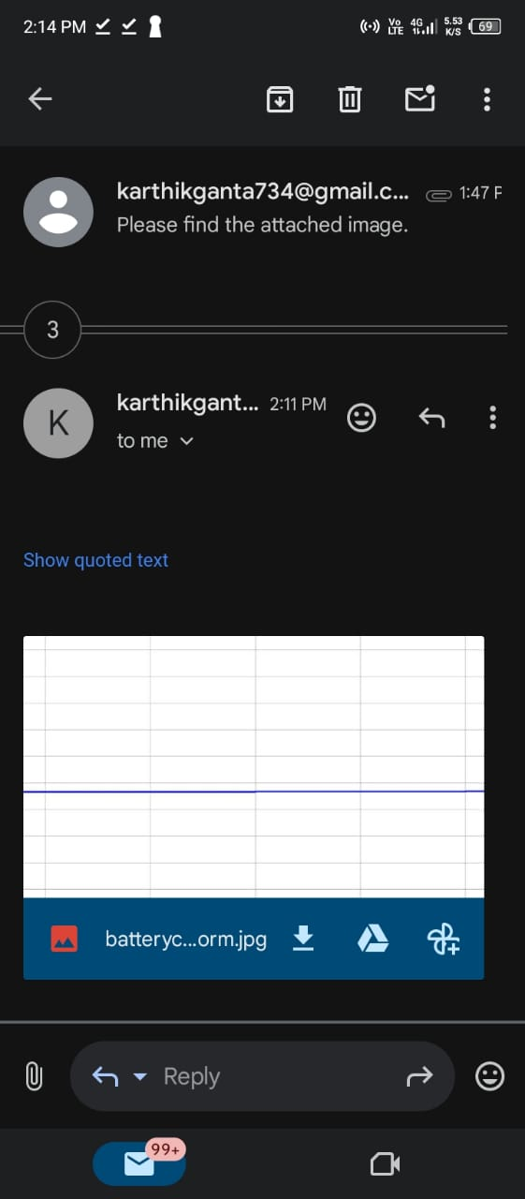
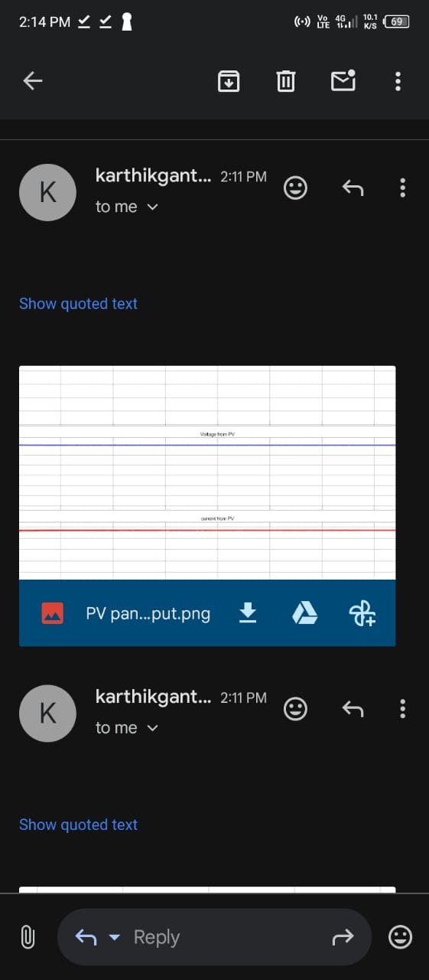
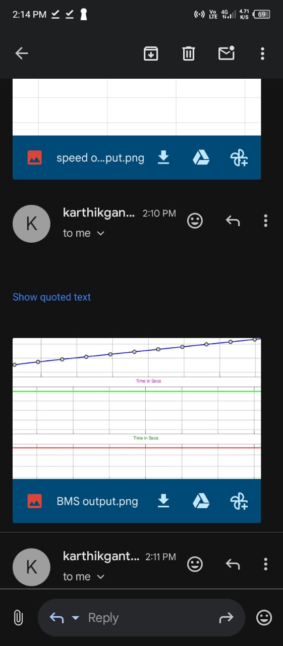
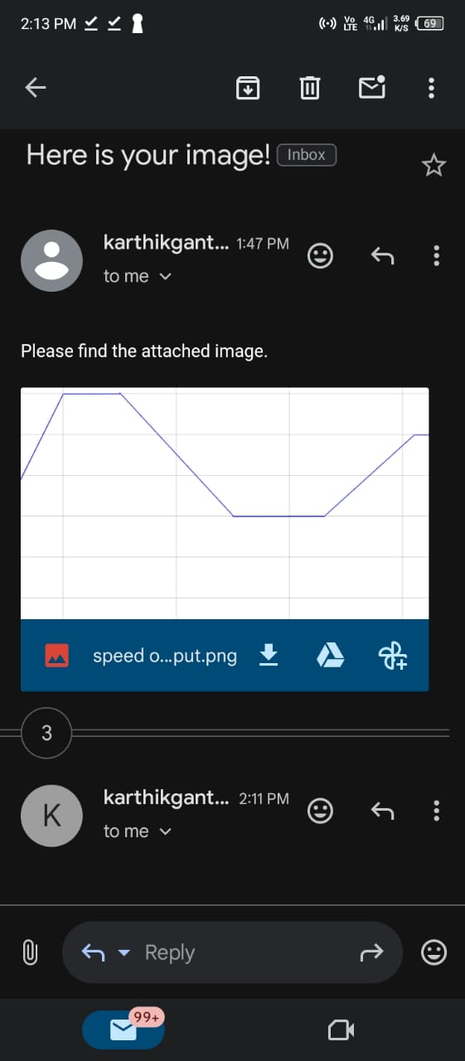
WORK DONE(contd…..)
Output of Monitoring System :-

Slide 27
CONCLUSION:-
This advanced monitoring system designed to enhance the efficiency and reliability of solar-powered electric vehicles. By integrating a real-time email-based monitoring system, this project ensures seamless communication of critical system parameters such as voltage, current, and battery health to users, enabling timely diagnostics and preventive maintenance. This enhances system transparency, user awareness, and operational safety. The implementation of a smoothing function circuit has effectively minimized voltage fluctuations and power ripples, ensuring a stable and reliable power supply to the vehicle’s electrical components. This not only improves the charging efficiency and battery life but also contributes to the overall energy efficiency of the electric vehicle. In essence, this project bridges the gap between clean energy generation and intelligent energy management. It provides a smart, scalable, and cost-effective solution that aligns with the future of sustainable transportation. With further enhancements such as AI-based analytics, mobile app integration, and wireless control, this system holds great potential to revolutionize how electric vehicles are monitored and managed in the era of green technology.

Slide 28
REFERENCES:-
Ahmad, Fareed, et al. "Optimal location of electric vehicle charging station and its impact on distribution network: A review." Energy Reports 8 (2022): 2314 2333.
Atawi IE, Hendawi E, Zaid SA. Analysis and Design of a Standalone Electric Vehicle Charging Station Supplied by Photovoltaic Energy.
M. Nour, H. Ramadan, A. Ali, and C. Farkas, “Impacts of plug-in electric vehicles charging on low voltage distribution network,” in 2018 International Conference on Innovative Trends in Computer (ITCE), 2018, pp. 357–362.
A. K. Karmaker, S. Roy, and M. R. Ahmed, “Analysis of the impact of electric vehicle charging station on power quality issues,” in 2019 International Conference on Electrical, Computer and Communication Engineering (ECCE), 2019, pp. 1–6.

Slide 29


